Slide 1
Unscented Kalman Filter

Slide 2
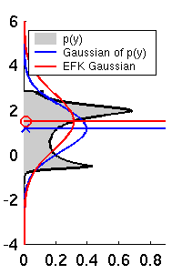
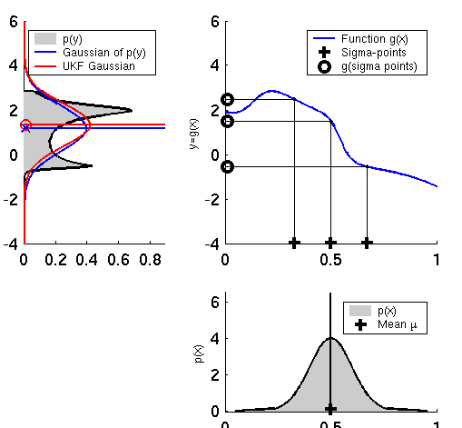
Linearization via Unscented Transform
EKF
UKF

Slide 3
Unscented Transform
intuition: it should be easier to approximate a given distribution than it is to approximate an arbitrary non-linear function
it is easy to transform a point through a non-linear function
use a set of points that capture the mean and covariance of the distribution, transform the points through the non-linear function, then compute the (weighted) mean and covariance of the transformed points

Slide 4
Empirical transformation of a Gaussian random variable
% generate 500,000 samples from N(0, 1)
x = randn(1, 500000);
% draw the histogram of x
xc = -5:0.2:5;
nx = hist(x, xc);
bar(xc, nx, 1);
% transform each sample by f(x)
y = nthroot(x – 1, 3);
% draw the histogram of y
xc = -2:0.1:2;
ny = hist(y, xc);
bar(xc, ny, 1);

Slide 5
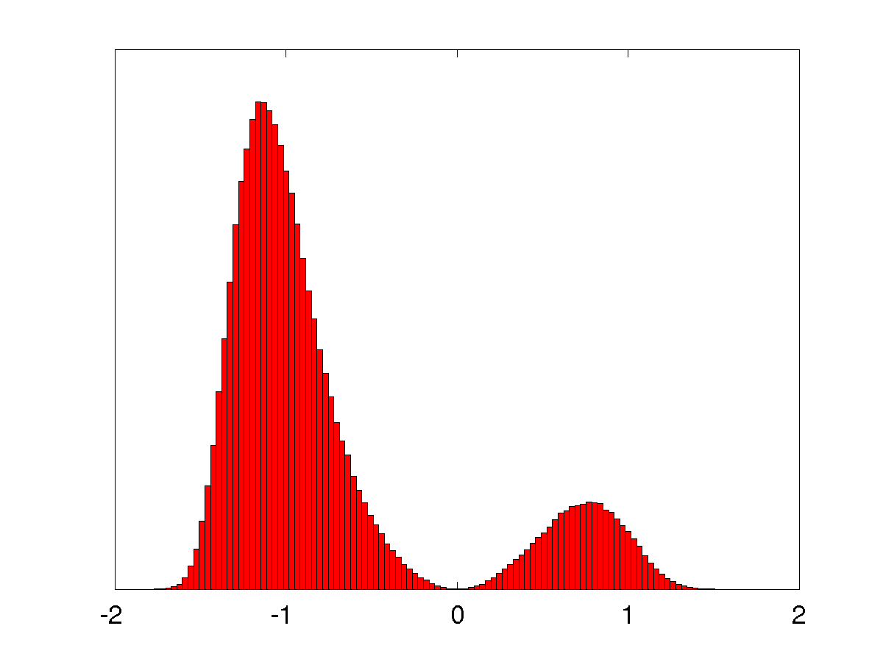
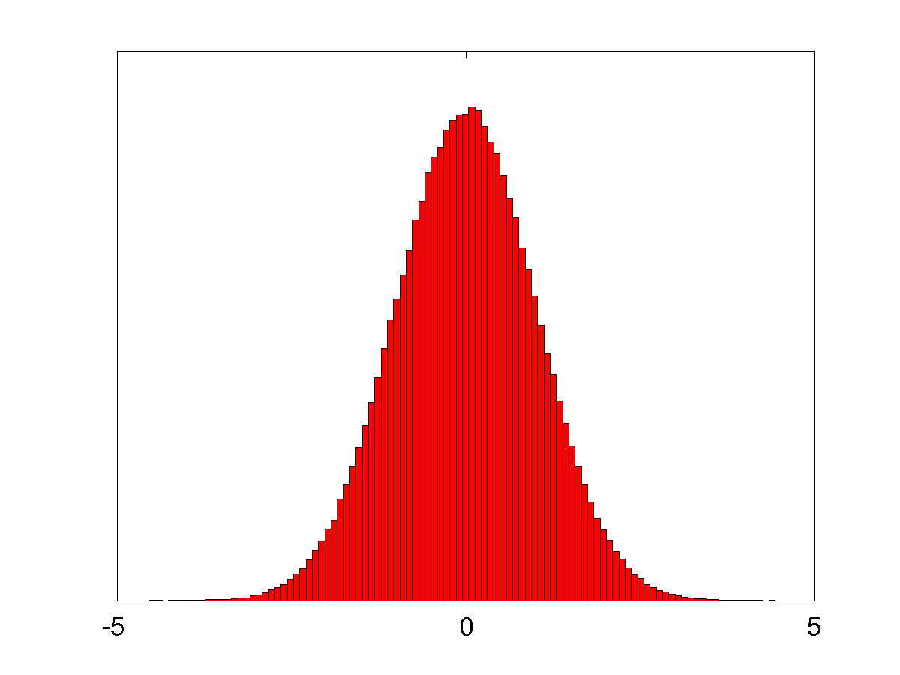
Empirical transformation of a Gaussian random variable
-transform 500,000 random
samples through a non-linear
function

Slide 6
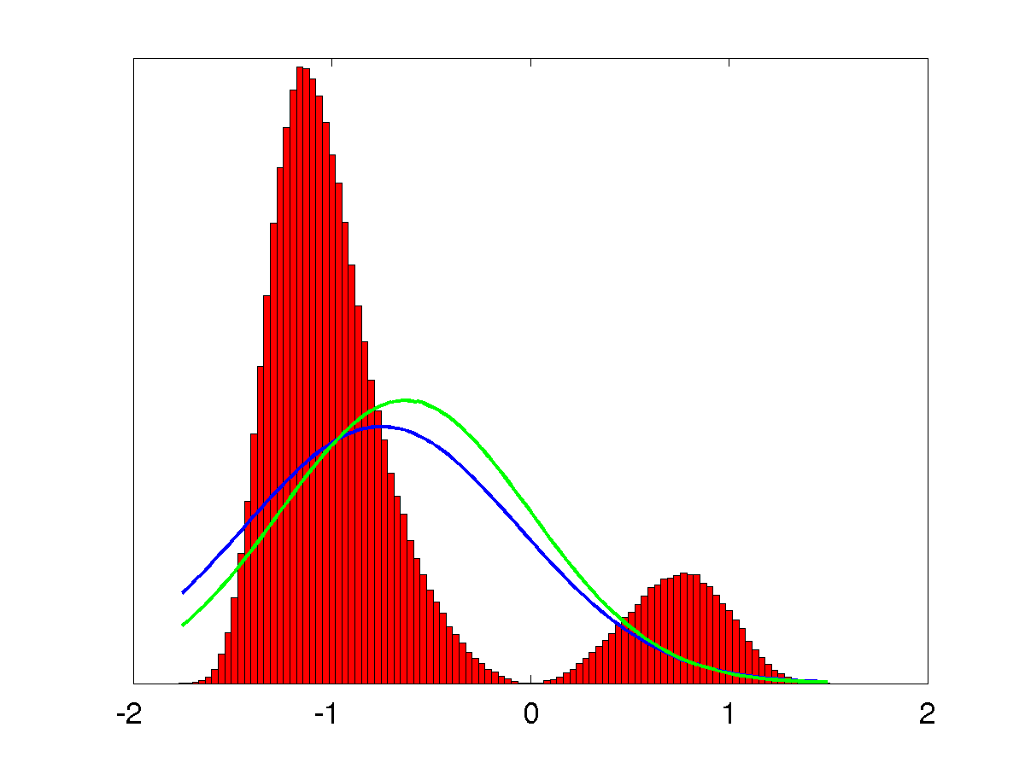
Unscented Transform
-transform 3 carefully chosen
samples through a non-linear
function
-samples are called sigma points

Slide 7
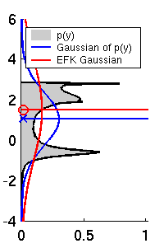
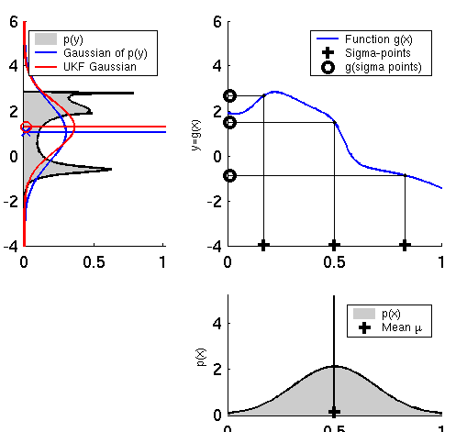
UKF Sigma-Point Estimate (2)
EKF
UKF

Slide 8
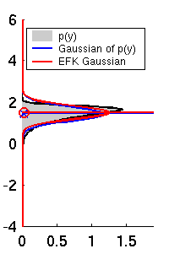
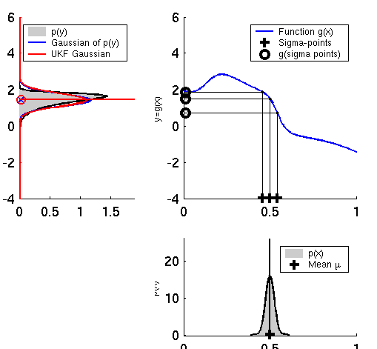
UKF Sigma-Point Estimate (3)
EKF
UKF

Slide 9
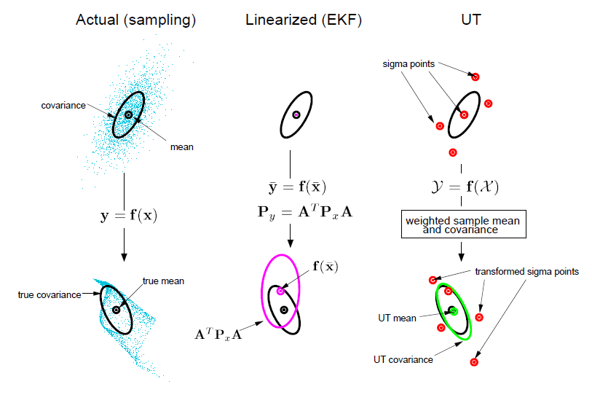
UKF Sigma-Point Estimate (4)

Slide 10
Unscented Transform
for an n-dimensional Gaussian with mean μ and covariance Σ , the unscented transform uses 2n+1 sigma points (and associated weights)
Sigma points Weights

Slide 11
Unscented Transform
choose κ ≥ 0 to guarantee a “reasonable” covariance matrix
value is not critical, so choose κ = 0 by default
choose 0 ≤ α ≤ 1
controls the spread of the sigma point distribution; should be small when nonlinearities are strong
choose β ≥ 0
β = 2 is optimal if distribution is Gaussian

Slide 12
Unscented Transform
Pass sigma points through nonlinear function
Recover mean and covariance

Slide 13
UKF_localization ( μ_{t-1}, Σ_{t-1}, u_{t}, z_{t}, m):
Prediction:
Control noise
Measurement noise
Augmented state mean
Augmented covariance
Sigma points
Prediction of sigma points
Predicted mean
Predicted covariance

Slide 14
UKF_localization ( μ_{t-1}, Σ_{t-1}, u_{t}, z_{t}, m):
Correction:
Measurement sigma points
Predicted measurement mean
Pred. measurement covariance
Cross-covariance
Kalman gain
Updated mean
Updated covariance

Slide 15
Augmented state
to account for the control noise sigma points are generated for the control variables
to account for the measurement noise sigma points are generated for the measurement variables
all sigma points can be generated in a single step by using an augmented state vector

Slide 16
Augmented state
Augmented state vector
$$μ_{t−1}^{a}=\left[\begin{matrix}μ_{t−1} \\ \begin{matrix}0 \\ 0\end{matrix} \\ \begin{matrix}0 \\ 0\end{matrix}\end{matrix}\right]$$

Slide 17
Augmented state sigma points
Generating sigma points with the augmented state yields sigma points each having components in state, control, and measurement

Slide 18
Augmented state sigma points
$$χ_{t−1}^{a}=\left[\begin{matrix}χ_{t−1}^{x} \\ χ_{t}^{μ} \\ χ_{t}^{z}\end{matrix}\right]$$

Slide 19
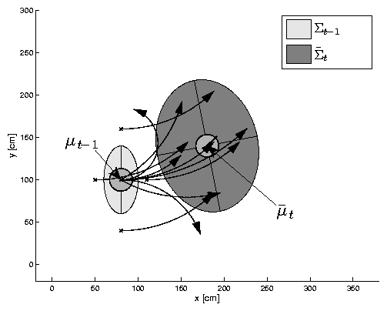
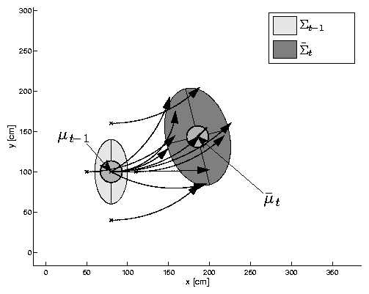
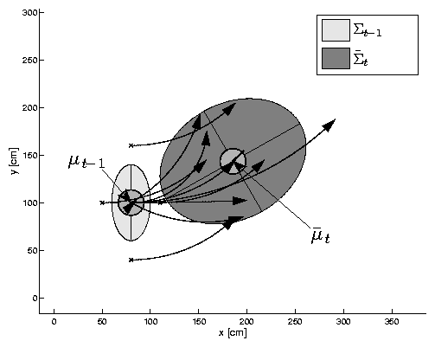
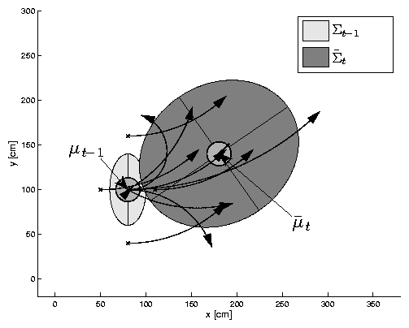
UKF Prediction Step

Slide 20
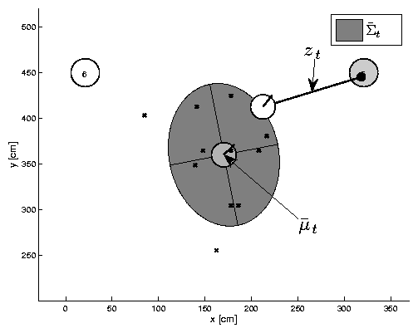
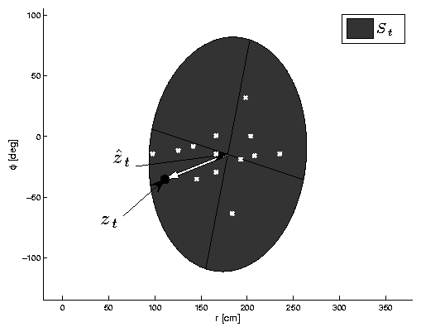
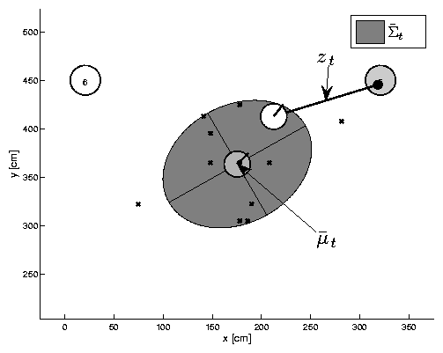
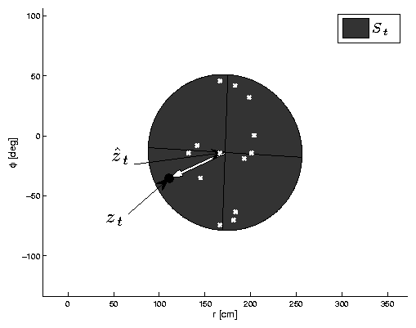
UKF Observation Prediction Step

Slide 21
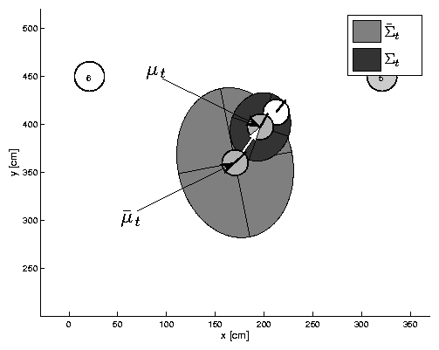
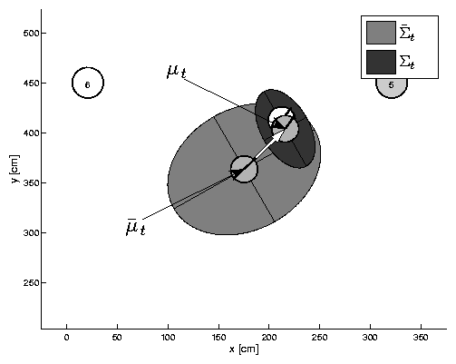
UKF Correction Step

Slide 22
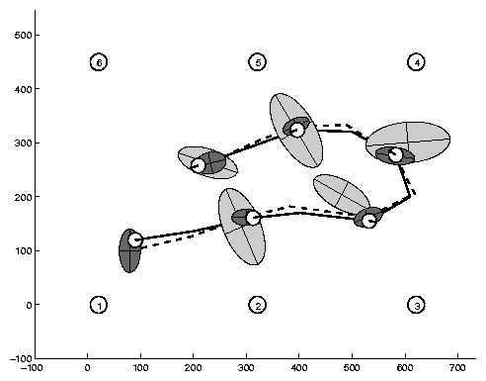
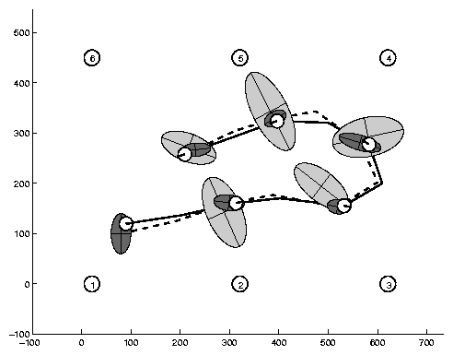
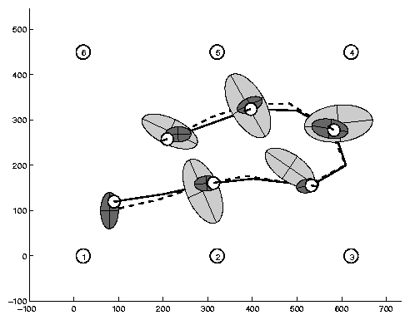
Estimation Sequence
EKF PF UKF

Slide 23
Estimation Sequence
EKF UKF

Slide 24
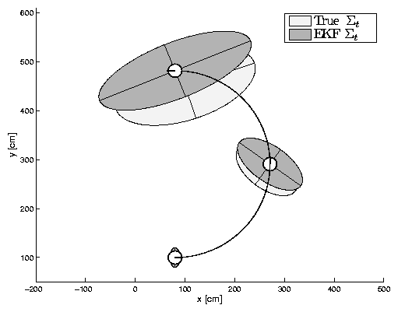
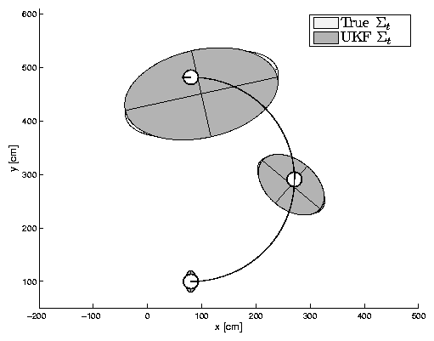
Prediction Quality
velocity_motion_model
EKF UKF

Slide 25
UKF Summary
Highly efficient: Same complexity as EKF, with a constant factor slower in typical practical applications
Better linearization than EKF: Accurate in first two terms of Taylor expansion (EKF only first term)
Derivative-free: No Jacobians needed
Still not optimal!

